Slide 1
Environment Protection (Banning of Plastic Bags) Regulations 2015
Ministry of Environment, Sustainable Development, and Disaster & Beach Management
December 2015

Slide 2
Banning of Plastic Bags
Announced as a Budget Measure in March 2015
Consultative Process initiated with key stakeholders
Regulations promulgated on 6th August 2015
Representations were made by operators
Consultations to review and amend regulations
Regulations promulgated on 5th December 2015
Regulations will be effective on 1st January 2016

Slide 3
Objectives of the Meeting
To share information on the provisions of the Environment Protection (Banning of Plastic Bags) Regulations 2015
Plastic bags targeted by the Regulations
Exempted Plastic Bags
Manufacture & Import of Biodegradable/Compostable Plastic Bags

Slide 4
The Regulations apply to:
Plastic bags used for carrying goods purchased at a point of sale
Plastic bags with or without handles or gussets, irrespective of their size, type and colour

Slide 5
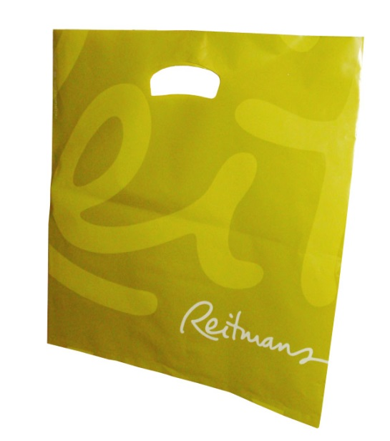
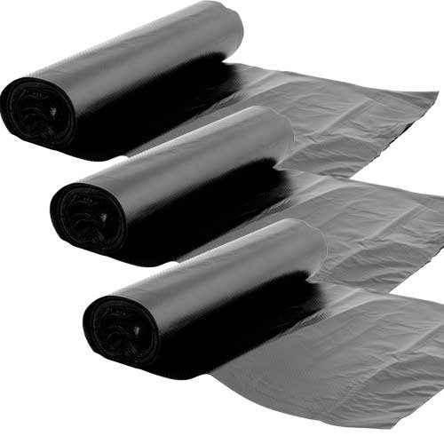
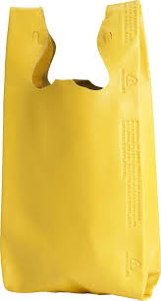
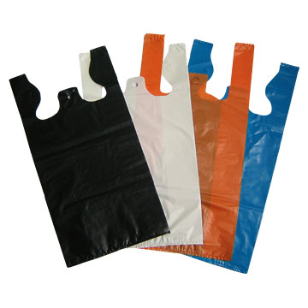
Plastic bags targeted by the Regulations
All plastic bags provided in wholesale & retail outlets, markets, fairs and by hawkers.
Vest-type plastic bags (sacs de caisse; sacs 50 sous)
Roll-on plastic bags
Non-Woven Polypropylene bags

Slide 6
Exempted Plastic Bags
11 types of plastic bags have been exempted for:
Essential uses
Hygienic and sanitary purposes

Slide 7
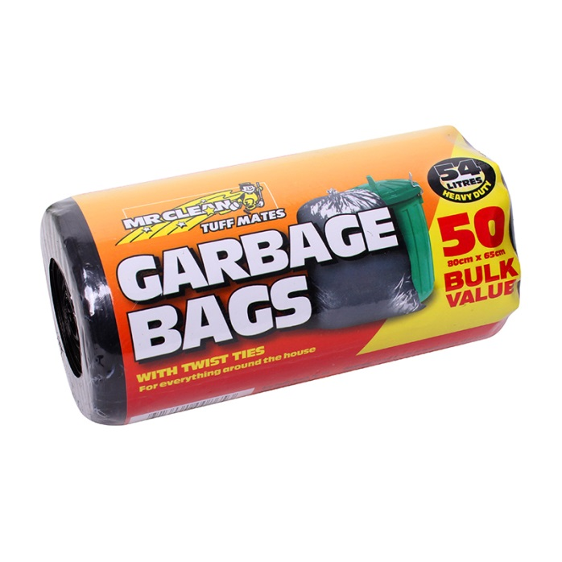
Exempted Plastic Bags
A transparent roll-on bag solely used to contain fresh, chilled or frozen seafood, meat, poultry, or offal other than canned food or eggs;
A bag designed to be used for the disposal of waste;
A bag designed for agricultural purposes;

Slide 8
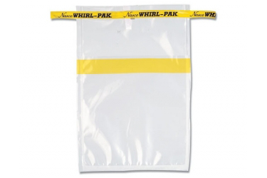
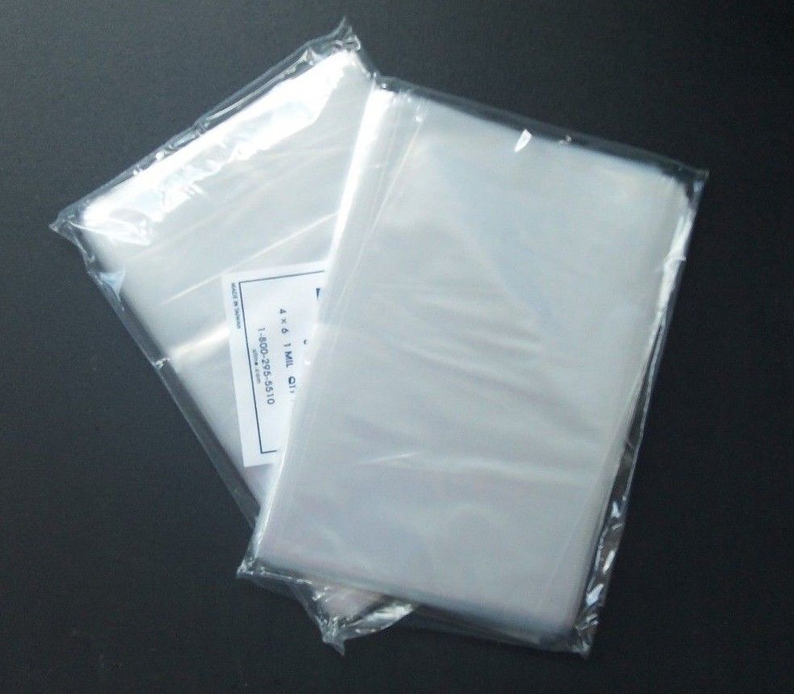
Exempted Plastic Bags
A bag used for the purpose of sampling or analysis;
A bag that constitutes, or forms an integral part of the packaging in which goods are sealed prior to sale on the local market or for export;
A transparent pocket-type bag not exceeding 300 cm² in size;

Slide 9
Exempted Plastic Bags
A transparent re-sealeable bag with security tamper used by a passenger to contain liquids, aerosols or gels at an airport or on board of an aircraft or carried by a transfer passenger;
A bag carried by a passenger disembarking from an aircraft or a ship for the purpose of carrying personal belongings; and
A bag manufactured for export.

Slide 10
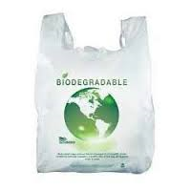
Exempted Plastic Bags
A biodegradable plastic bag on which particulars are conspicuously displayed and;
A compostable plastic bag on which particulars are conspicuously displayed

Slide 11
As from 1st January 2016
“No person shall import, manufacture, sell or supply a plastic bag”

Slide 12
Manufacturers & Importers of Exempted Plastic Bags
MANDATORY to register with the Director of Environment
Application Form available online (http://environment.govmu.org)
The Director will register a manufacturer or an importer of exempted plastic bags under terms and conditions as he may determine

Slide 13
Biodegradable/Compostable Plastic Bags

Slide 14
Biodegradable/Compostable Bags should:
Conform to the standards specified in the Regulations.
Be conspicuously displayed with the following details:
Name and contact address of the importer or manufacturer
Country of origin of biodegradable/compostable plastic bags
Batch number & production date
Standard complied with

Slide 15
Applicable Standards
Biodegradable plastic bags
Compostable plastic bags
ASTM D5338-15 ASTM D6340-98
ASTM D5988-12 ASTM D6954-04
EN 14047 EN 14046
EN 14048 EN 13432
ISO 14851 ISO 14852
ISO 14855-1 ISO 14855-2
ISO 15985 ISO 17556
ASTM D6400-12
EN 13432
EN 14045
EN 14995
ISO 17088
ISO 20200
ISO 16929

Slide 16
Offence
Any person contravening these regulations shall commit an offence.

