Slide 1
Environment Protection (Banning of Plastic Bags) Regulations 2015
Ministry of Environment, Sustainable Development, and Disaster & Beach Management
December 2015

Slide 2
Banning of Plastic Bags
Announced as a Budget Measure in March 2015
Consultative Process initiated with key stakeholders
Regulations promulgated on 6th August 2015
Representations were made by operators
Consultations to review and amend regulations
Regulations promulgated on 5th December 2015
Regulations will be effective on 1st January 2016

Slide 3
Roadmap
Promulgation of Regulations
(Aug & Dec 2015)
Sensitisation & Awareness Raising
Enforcement for successful implementation of the Regulations

Slide 4
Objectives of the Presentation
To share information on the provisions of the Environment Protection (Banning of Plastic Bags) Regulations 2015
Plastic bags targeted by the Regulations
Exempted Plastic Bags
Manufacture & Import of Biodegradable/Compostable Plastic Bags

Slide 5
The Regulations apply to:
Plastic bags designed for carrying goods purchased at a point of sale
Plastic bags with or without handles or gussets, irrespective of their size, type and colour

Slide 6
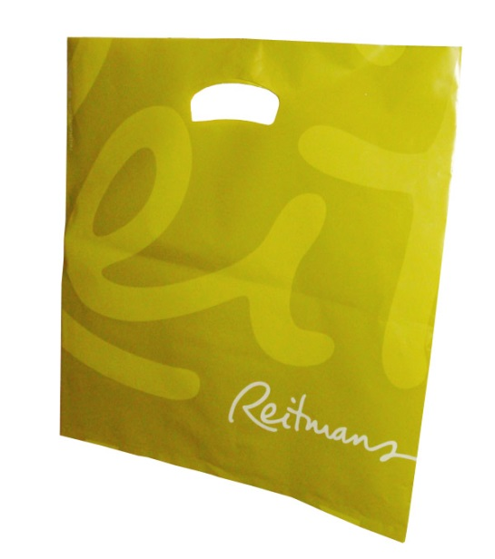
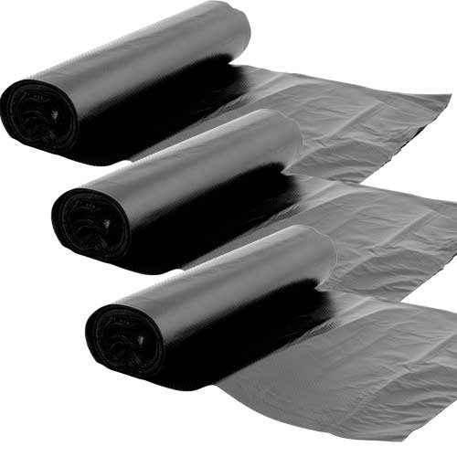
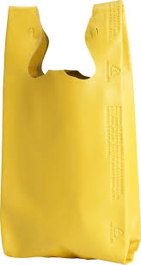
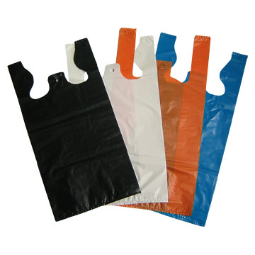
Plastic bags targeted by the Regulations
All plastic bags provided in wholesale & retail outlets, markets, fairs and by hawkers.
Vest-type plastic bags (sacs de caisse; sacs 50 sous)
Roll-on plastic bags
Non-Woven Polypropylene bags

Slide 7
Exempted Plastic Bags
11 types of plastic bags have been exempted for:
Essential uses
Hygienic and sanitary purposes

Slide 8
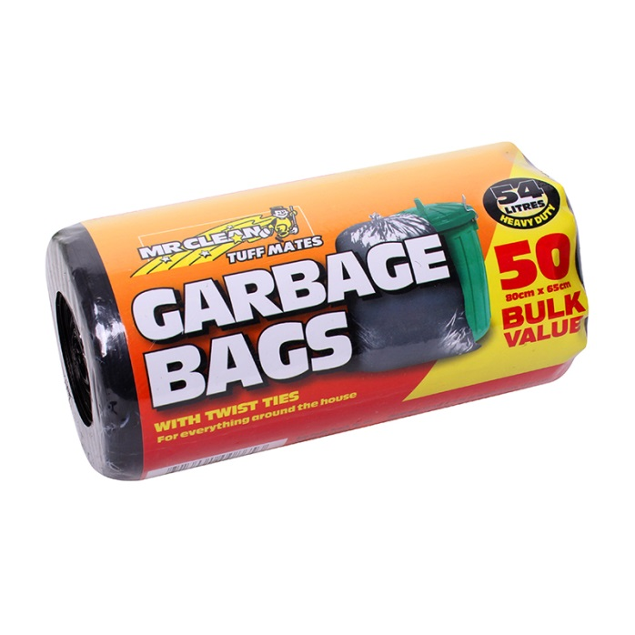
Exempted Plastic Bags
A transparent roll-on bag solely used to contain fresh, chilled or frozen seafood, meat, poultry, or offal other than canned food or eggs;
A bag designed to be used for the disposal of waste;
A bag designed for agricultural purposes;

Slide 9
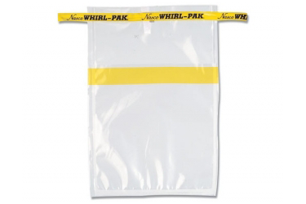
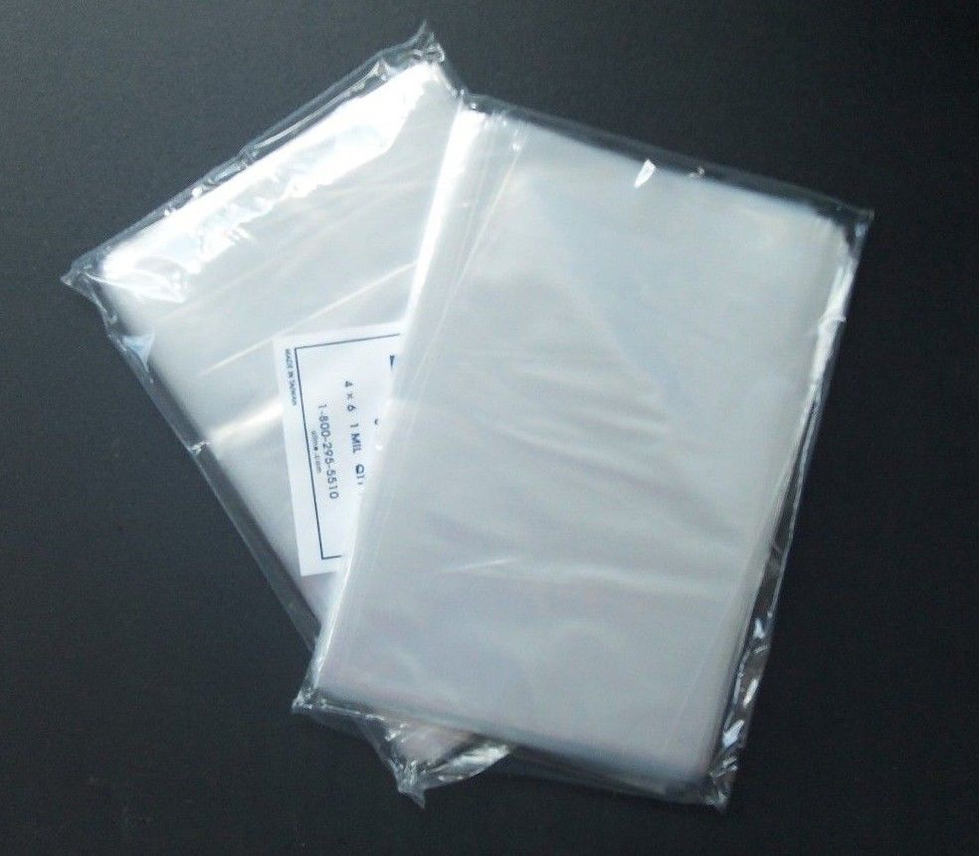
Exempted Plastic Bags
A bag used for the purpose of sampling or analysis;
A bag that constitutes, or forms an integral part of the packaging in which goods are sealed prior to sale on the local market or for export;
A transparent pocket-type bag not exceeding 300 cm² in size;

Slide 10
Exempted Plastic Bags
A transparent re-sealeable bag with security tamper used by a passenger to contain liquids, aerosols or gels at an airport or on board of an aircraft or carried by a transfer passenger;
A bag carried by a passenger disembarking from an aircraft or a ship for the purpose of carrying personal belongings; and
A bag manufactured for export.

Slide 11
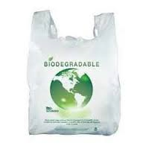
Exempted Plastic Bags
A biodegradable plastic bag on which particulars are conspicuously displayed and;
A compostable plastic bag on which particulars are conspicuously displayed

Slide 12
Biodegradable/Compostable Bags should:
Be conspicuously displayed with the following details:
Name and contact address of the importer or manufacturer
Country of origin of biodegradable/compostable plastic bags
Batch number & production date
Standard complied with
Conform to the standards specified in the Regulations.

Slide 13
Applicable Standards
Biodegradable plastic bags
Compostable plastic bags
ASTM D5338-15 ASTM D6340-98
ASTM D5988-12 ASTM D6954-04
EN 14047 EN 14046
EN 14048 EN 13432
ISO 14851 ISO 14852
ISO 14855-1 ISO 14855-2
ISO 15985 ISO 17556
ASTM D6400-12
EN 13432
EN 14045
EN 14995
ISO 17088
ISO 20200
ISO 16929

Slide 14
Manufacturers & Importers of Exempted Plastic Bags
MANDATORY to register with the Director of Environment
Application Form available online (http://environment.govmu.org)
The Director will register a manufacturer or an importer of exempted plastic bags under terms and conditions as he may determine

Slide 15
Registration Form for Manufacturers & Importers of exempted

Slide 16
As from 1st January 2016
“No person shall import, manufacture, sell or supply a plastic bag”

Slide 17
Offence
Any person contravening these regulations shall commit an offence.

Slide 18
Enforcement and Monitoring Mechanisms
Who are involved?
Where to enforce?
What types of bags are concerned?
What are expected from the enforcement officers?
Awareness within institutions
Mode of operation
Regular Reporting at ELO meetings

Slide 19
Who are involved :
Ministry of Environment, SD & DBM
Enforcing Agencies
Local Authorities

Slide 20
Targeted operators
Manufacturers Level
Local Authorities, MoESD&DBM & Police de l’Environnement
Manufacturers of Exempted Plastic Bags
Distribution Level
Local Authorities, MoESD&DBM & Police de l’Environnement
Sale, Supply & Distribution at Points of Sale (Markets, Fairs, Retail & wholesale outlets, hawkers)
Importers
MoESD&DBM / MSB / MRA
Control through Registration Certificate and Clearance

Slide 21
Sensitisation & Awareness at Agency level
20 Banners to be displayed near main markets and strategic places
10 000 Flyers to be distributed to market traders via Local Authorities
10 000 Posters to be distributed
LED messages by 3 local authorities
Billboards at 15 strategic sites on the motorway
Talks, training of trainers, radio spots and TV clips
Dossier Programmes
Scrolling Messages
Website (http://environment.govmu.org)

Slide 23
Mode of operation
Regular Routine Patrol
Visits for sensitization
Surprise checks
Additional information:
Samples of biodegradable bags
List accredited laboratories

Slide 24
List accredited laboratories
BETA ANALYTICS Inc, USA
Advanced Materials Centre Inc, USA
Organic Waste Systems, USA
Soil Control labs, USA
MATERIA NOVA-NATISS, Belgium
OWS, Belgium
CHELAB-SILLIKER, Italy
ITENE, Spain

Slide 25
List accredited laboratories (Cont.)
Dr. U. Noack Laboratorium fur angewandte Biologie, Germany
Fraunhofer-Institut fur Umwelt-Sicherheits, Germany
Ingenieurgesellshaft fur Umweltplanug, Germany
National Centre for Testing & Supervision for Quality of Plastics, China
Korea Institute of Industrial Technology, South Korea
Plastics Industry Development Centre, Taiwan

Slide 26
Successful implementation of Regulations
Sustained & Continuous enforcement
Collaboration from Enforcing Agencies
Regular reporting
Networking and Information sharing

